Slide 1

Fault Detection in Bikes using AI & ML
Final Version Based on Model Implementation

Slide 2
Objective
Develop an AI-based system to classify bike noises to diagnose mechanical issues: engine, brake, chain, and suspension.
Automate the analysis of sound data using MFCC features and ML models to aid mechanics and service centers.

Slide 3
Technologies Used
Python: Main programming language.
Librosa: For audio feature extraction (MFCCs).
NumPy & Pandas: For data handling and transformations.
Scikit-learn: ML models, preprocessing, and evaluation.
Matplotlib: For visualization of model performance.

Slide 4
Methodology
Data Collection: Audio recordings categorized by issue type.
Feature Extraction: 20-dimensional MFCCs extracted using Librosa.
Data Preprocessing: Label encoding, standardization, data shuffling.
Data Augmentation: Gaussian noise added to MFCCs to simulate real-world noise variations.
Train-Test Split: Manual split used for simplicity (200 train / 19 test).

Slide 5
Machine Learning Models
Random Forest Classifier: n_estimators=120, max_depth=10
Support Vector Machine: kernel=rbf, C=0.3, gamma=0.07
K-Nearest Neighbors: k=8, uniform weights
All models trained and evaluated on the same dataset for fair comparison.

Slide 6
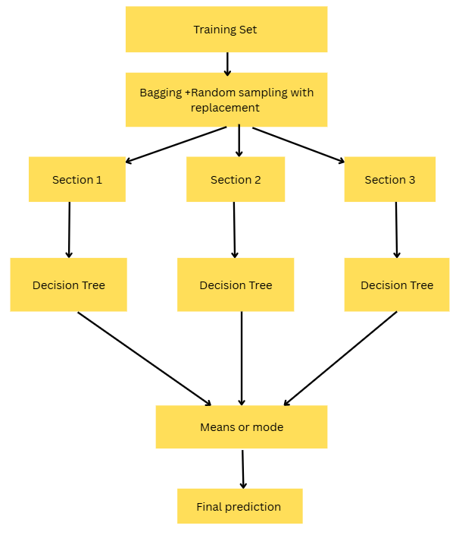
Random Forest

Slide 7
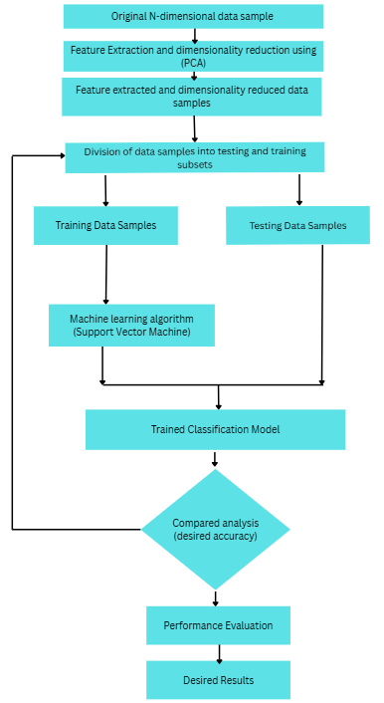
SVM

Slide 8
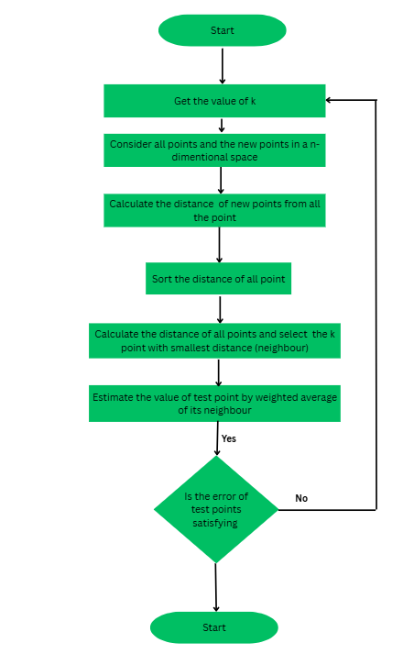
KNN

Slide 9
Model Performance Comparison
Evaluation Metrics: Accuracy, Classification Report
Best Performing Model: Random Forest
Models showed reasonable performance despite small dataset size.

Slide 10
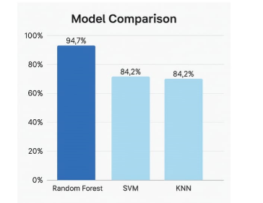
Accuracy Comparison :
Model | Reason for Rank
Random Forest | Ensemble, handles noise & small data well
SVM | Good with scaling & tuning, but complex
KNN | Poor generalization, bad with tiny data

Slide 11
Challenges & Solutions
Limited Data: Augmented data using Gaussian noise.
Overlapping Sounds: Focused on clear MFCC-based features.
Overfitting: Used cross-validation and tuning (GridSearchCV).
Evaluation: Manually tested against diverse test samples.

Slide 12

Future Scope
Use larger and more diverse datasets.
Deploy real-time analysis via mobile app or IoT device.
Explore deep learning (CNNs, RNNs) for improved accuracy.
Develop user-friendly UI for non-technical users.

Slide 13
Conclusion
Successfully implemented an audio-based fault detection system for bikes.
Used MFCCs and 3 ML models to identify mechanical issues.
Random Forest showed the best accuracy on test data.
System shows potential for real-world deployment and expansion.

Slide 14
Submitted by
Mohammad Kazim PRN: 2114110466
Aryan Gupta PRN: 2114110452
Faiz Maqsood PRN: 2114110489
Under the Guidance of
Dr. Harshada Mhetre

Slide 15
Thank You
Questions & Discussions Welcome!

